Slide 1
SDLC Models
-Barath S Sundar
-Subash M
-Vaishnavi G

Slide 2
What is SDLC ?

Slide 3
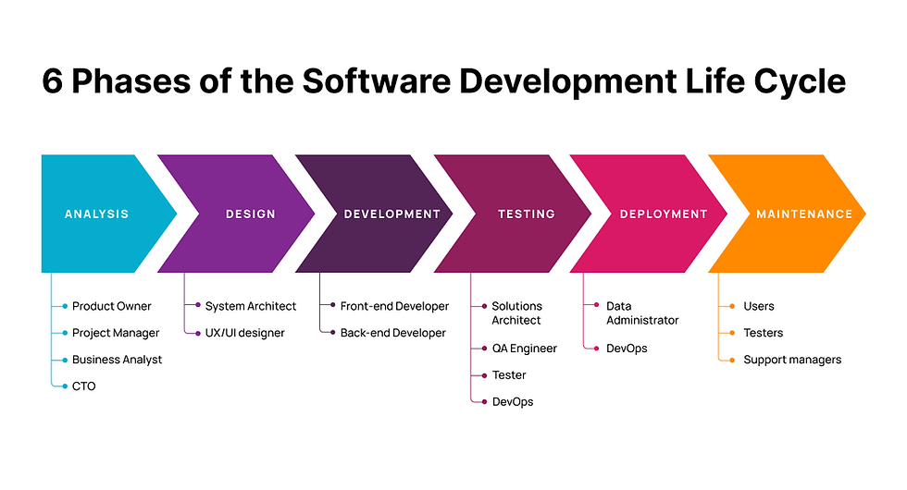

Slide 4
Why SDLC?
Establishing appropriate levels of management
Accountability
Traceability
Ensuring that projects are developed within the current and planned information technology infrastructure
Identifying project risks and issues early and manage them before they become problems

Slide 5
Types of Models 1. Waterfall Model 2. VV Model 3. Iterative Model 4. Spiral Model 5. Agile Model 6. DevOps Model

Slide 6
Waterfall Model
The Waterfall model is a linear, sequential approach to software development where each phase must be completed before moving on to the next.
Visualize the Waterfall model using a downward flowchart. Highlight how each phase follows sequentially, and emphasize that each phase needs to be completed before moving on to the next.

Slide 7
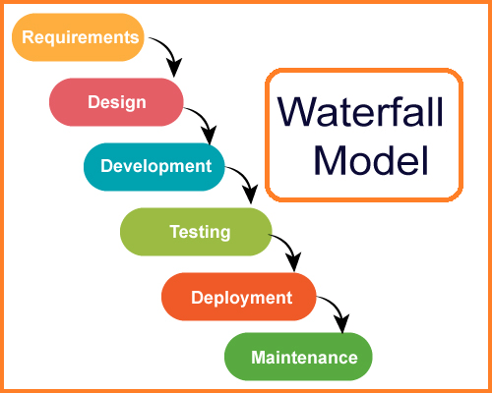

Slide 8
Application of Waterfall
Projects with well-defined requirements and minimal expected changes. Example: Banking Software, Payroll Systems, Government Projects
These systems often require strict requirements and regulatory adherence from the outset. Since changes are limited, a structured, step-by-step approach is suitable.

Slide 9
V-Model
The V-Model, also known as the Verification and Validation Model, is an extension of the Waterfall model. It emphasizes the parallel relationship between development and testing phases, where each development phase has a corresponding testing phase

Slide 10
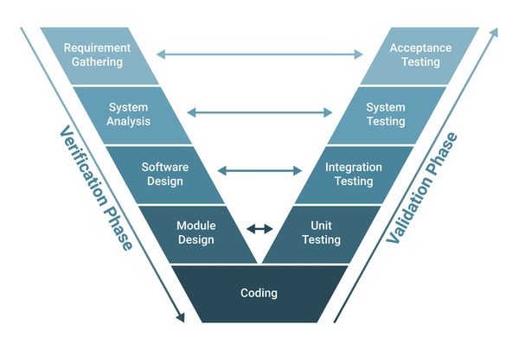

Slide 11
Application of V-Model
Systems requiring rigorous testing for accuracy and compliance.
Example: Medical Device Software, Embedded Systems (e.g., automotive control software)
V-Model is used in industries like healthcare and automotive, where the software must go through extensive testing phases due to high safety and accuracy requirements.

Slide 12
Aspect | Waterfall Model | V-Model
Process Flow | Sequential (one phase after the other). | Sequential but with parallel testing.
Flexibility | Less flexible once the process begins. | More flexible than Waterfall, but still rigid.
Testing | After development phase. | Testing starts in parallel with development.
Ideal Use Cases | Small, well-defined projects. | Projects with well-defined requirements and where high quality is required.
Risk | Higher risk of rework if changes are needed. | Lower risk of defects due to early testing.
Documentation | Heavy documentation at each phase. | Heavy documentation with a focus on verification and validation.

Slide 13
Iterative Model
The Iterative model is an approach to software development where the system is designed, implemented, and tested in repeated cycles (iterations). Each cycle results in a new version of the software, which builds on the previous one.

Slide 14
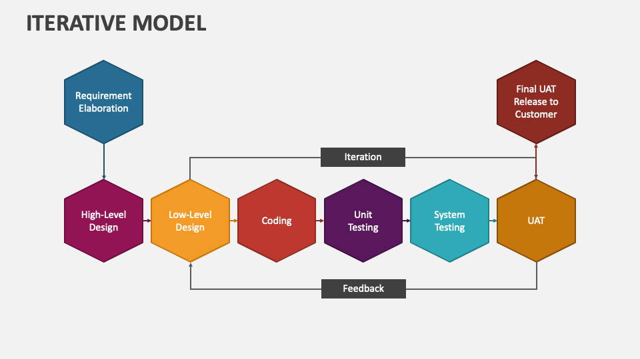

Slide 15
Applications of Iterative Model
Projects where requirements are clear but might need refinement over multiple cycles.
Example: Customer Relationship Management (CRM) systems, Enterprise Resource Planning (ERP) systems
In CRM or ERP software, core features can be developed first and then iterated on to add more functionality, allowing feedback-based improvement.

Slide 16
Spiral Model
The Spiral model combines iterative development with systematic risk management. It emphasizes frequent refinement of the software and includes a strong focus on identifying and mitigating risks throughout the development process.

Slide 17
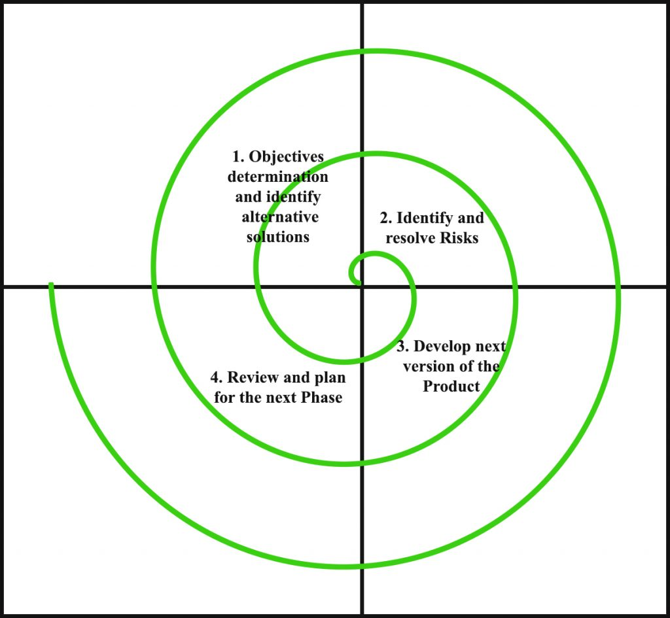

Slide 18
Key Phases:
Planning: Determine objectives, alternatives, and constraints of the project.
Risk Analysis: Identify and evaluate potential risks, and decide on mitigation strategies.
Engineering and Development: Develop the product based on the current iteration’s objectives.
Testing and Evaluation: Test the current build, gather feedback, and evaluate progress.
Planning for the Next Iteration: Based on the current iteration, plan the next iteration with revised objectives and strategies.

Slide 19
Application of Spiral Model
Large-scale, high-risk projects where requirements may evolve, and risk assessment is critical.
Example: Telecommunications Systems, Aerospace Software
In fields like telecommunications or aerospace, risk management and progressive refinement are crucial due to the complexity and high stakes involved, making the Spiral Model an ideal approach.

Slide 20
Aspect | Iterative Model | Spiral Model
Process Flow | Cycles of design, development, testing, and feedback. | Cycles of planning, risk analysis, development, and testing.
Focus | Focus on building the software through repeated iterations. | Focus on risk management alongside iterative development.
Flexibility | Highly flexible, changes can be incorporated between iterations. | Extremely flexible with ongoing risk analysis and adaptation.
Risk Management | Limited risk management (depending on iteration). | Strong emphasis on identifying and mitigating risks early.
Ideal Use Cases | Projects where requirements evolve over time, or are unclear. | Large, complex, and high-risk projects requiring extensive analysis and risk mitigation.
Documentation | Less formal documentation, focuses on iterative development and feedback. | Requires comprehensive documentation due to risk analysis and planning at each phase.

Slide 21
Agile Model
The Agile model is an iterative and incremental approach to software development that emphasizes collaboration, flexibility, and customer feedback. Agile encourages frequent delivery of small, working pieces of software and responds quickly to changing requirements.

Slide 22
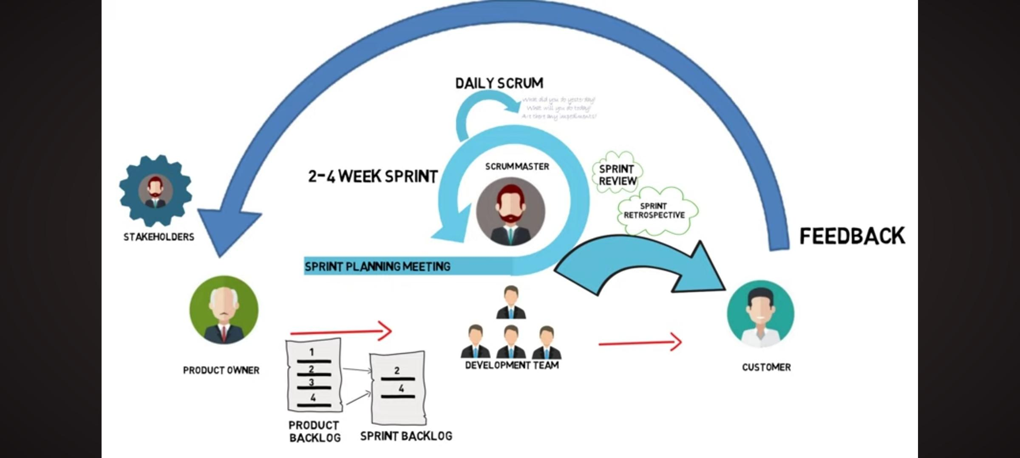

Slide 23
Key Principles:
Individuals and interactions over processes and tools.
Working software over comprehensive documentation.
Customer collaboration over contract negotiation.
Responding to change over following a plan.

Slide 24
Key Phases:
Planning: High-level project planning with a focus on defining the product vision and setting goals.
Design & Development: The design and coding are done incrementally in short iterations (often called "sprints").
Testing: Testing happens continuously during each iteration.
Release: After each iteration, a potentially shippable product increment is delivered.
Review & Retrospective: At the end of each sprint, a review meeting is held to gather feedback, and a retrospective meeting is held to discuss improvements for the next sprint.

Slide 25
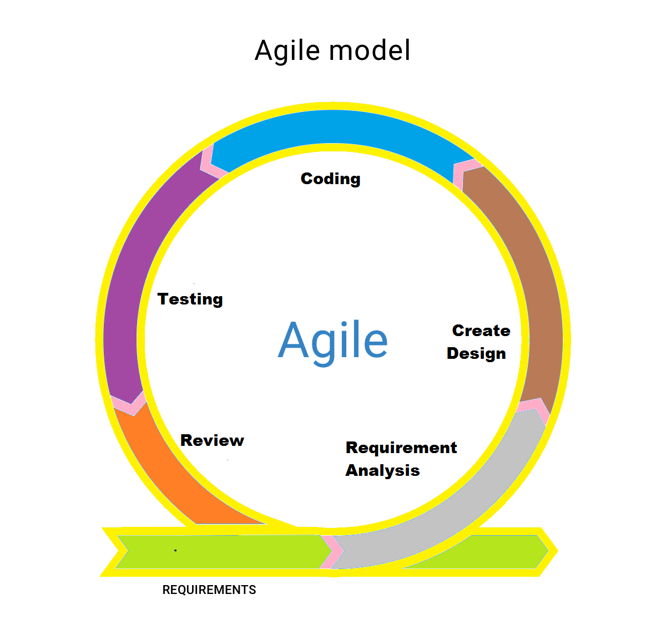

Slide 26
Applications of Agile Model
Projects requiring flexibility and continuous iteration with user feedback.
Example: E-commerce Websites, Mobile Apps (e.g., social media platforms), Software-as-a-Service (SaaS) products.
For dynamic products like e-commerce sites or SaaS applications, Agile supports frequent releases, quick adaptation to market needs, and continuous delivery of new features.

Slide 27
Scrum Framework
It is an Agile framework that divides projects into fixed-length iterations, known as sprints, typically lasting 2-4 weeks. It is structured with defined roles, events, and artifacts that promote incremental progress and iterative feedback. Key Principles of Scrum
Sprints
Defined Roles:
Product Owner
Scrum Master
Development Team.
Daily Standup Meetings
Sprint Planning and Retrospectives

Slide 28
Kanban Framework
It is a visual workflow management framework that helps teams visualize their work, limit work in progress (WIP), and optimize flow. It is based on continuous delivery and improvement, rather than structured iterations.
Example: Customer Support Team

Slide 29
DevOps Model
DevOps is a culture and set of practices that aim to improve collaboration between development (Dev) and IT operations (Ops) teams. It emphasizes automation, continuous integration (CI), continuous delivery (CD), and rapid delivery of high-quality software

Slide 30
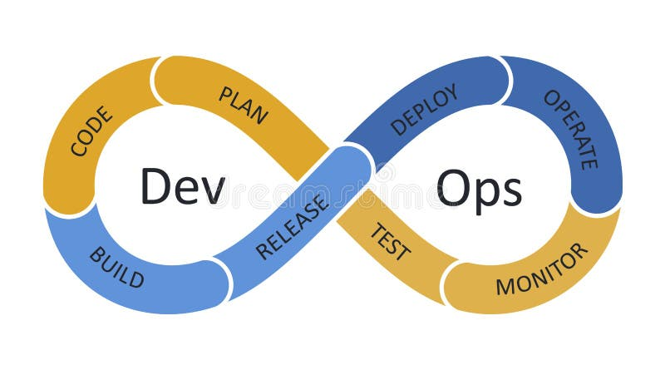
Dev-ops Model
Plan (Collaborative planning between Dev and Ops)
Develop (Development and testing of features)
Build (Code is compiled and built)
Test (Automated tests run to ensure quality)
Release (Deploying changes to production)
Deploy (Continuous delivery and deployment)
Operate (Running the application in production)
Monitor (Continuous monitoring of performance and feedback loops)

Slide 31
Aspect | Agile Model | DevOps Model
Focus | Focuses on iterative software development and frequent delivery of small increments. | Focuses on collaboration between development and operations, automation, and continuous delivery.
Process Flow | Works in short cycles (sprints), allowing frequent delivery and adaptation to change. | Continuous integration, continuous delivery, and automation of the entire development-to-deployment pipeline.
Team Collaboration | Strong collaboration between developers and business stakeholders. | Strong collaboration between development and operations teams.
Release Frequency | Frequent releases in iterations (e.g., every 2-4 weeks). | Continuous delivery of small, incremental updates to production.
Tools & Automation | Agile teams may use tools for task tracking (JIRA, Trello), but less focus on automation. | DevOps relies heavily on automation tools (CI/CD tools like Jenkins, Docker, Kubernetes) for testing, deployment, and monitoring.
Ideal Use Cases | Projects with dynamic and changing requirements. | Large-scale applications with frequent deployments and a need for high collaboration between Dev and Ops.
Challenges | Requires strong customer collaboration; potential for scope creep. | Requires a cultural shift in the organization; complex toolchain setup.

Slide 32
Applications of DevOps Model:
Projects needing rapid deployment, continuous integration, and constant monitoring.
Example: Cloud-Based Applications (e.g., Netflix, Amazon Web Services), Microservices, Architecture-Based Applications
DevOps is perfect for cloud platforms, streaming services, or applications with high user demands. Continuous deployment and automated testing ensure fast feature rollouts and high system reliability.

Slide 33
Thank you!

